Slide 1
Events
Srikar Mylavarapu

Slide 2
Questions from a time past
-- init properties for anonymous classes
* If two or more anonymous object initializers in an assembly specify a sequence of properties that are in the same order and that have the same names and types, the compiler treats the objects as instances of the same type. They share the same compiler-generated type information.
-- what level do anonymous types get disambiguated at/how visible are they
C# Anonymous Types – Tutlane Method it’s initialized in
Auto implemented event property

Slide 3
Disclaimer
15 pages of hell
Jeffrey 1 – Srikar 0
Goal is always to get you to be able to figure out the rest
So we’re going to just locally create a working version of what’s in the book

Slide 4
Event Theory
Medical System Cruelty
Time to do something
Resident’s Pager
Being a good resident, s/he decided to sleep through the pager… Their Attending decided to use the nuclear option

Slide 5
What do we need to get to this System
Medical System Cruelty
Resident’s Pager
Resident’s Cell Phone
Resident’s Email

Slide 6
What do we need to get to this System
How do you sign up?
How do we keep track of who to notify?
Medical System Cruelty
What Method’s do we need
Can the messages be different?
Resident’s Pager
Resident’s Cell Phone
Email

Slide 7
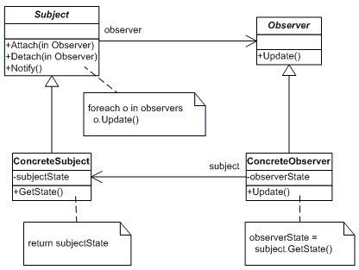
Diagram from GO4. We’re going to do the ‘concrete’ parts

Slide 8
What is a delegate in simple terms
Basically a type safe function pointer
More specifically, a type safe reference to a function.
Not the primary goal of this chapter so that’s all we’ll need.

Slide 9
Volatile
Not Thread safe
Multiple threads can access at once
We use it once, it’s kind of ok to just ignore it here.

Slide 10
Let’s look at Jeffrey’s code
* He added tons of comments/things that are honestly beyond me, so I have a ‘cleaned’ version

Slide 11
What does the Compiler do with an event
Creates a private ‘delegate field’
Add
Remove
Remove on an object that doesn’t exist?

Slide 12
Jeffrey’s Steps for Success
Define your message type
“call this your RNA”
Define your event member
Define your method responsible for raising event and notifying the objects event occurred.
Define how method translates input into desired event
Create your ‘listeners’ and connect them

